Slide 1
Topic: Quadratic transformations
Term 4 – Week 4
Ms. Latham
Year 10 – Coordinate Geometry
EQ: What are the transformations of a parabola?

Slide 2
Overview
Understand the different parts of a quadratics equation
How the different parts will transform when graphed
Students will need a half page of graph paper

Slide 3
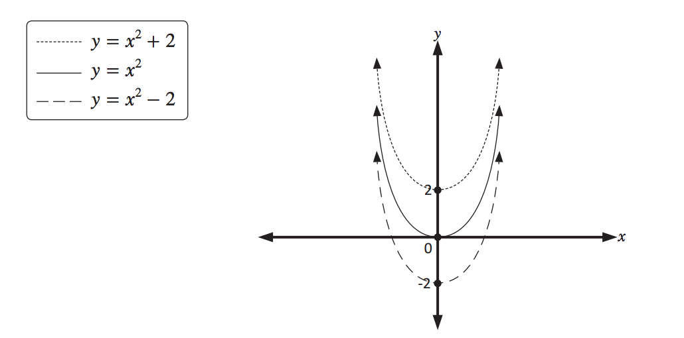
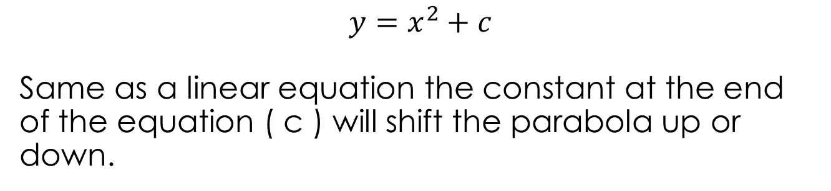
Topic : Quadratics Transformation
What are the transformations of a parabola?
$$y=x^{2}+c$$
Same as a linear equation the constant at the end of the equation ( c ) will shift the parabola up or down.
What shifts a parabola vertically?
The graphs below are of y =x ² - 2 y = x² = and y = x² + 2 .
Adding units to a parabola shifts it up,
and
subtracting units from a parabola shifts it down.

Slide 4
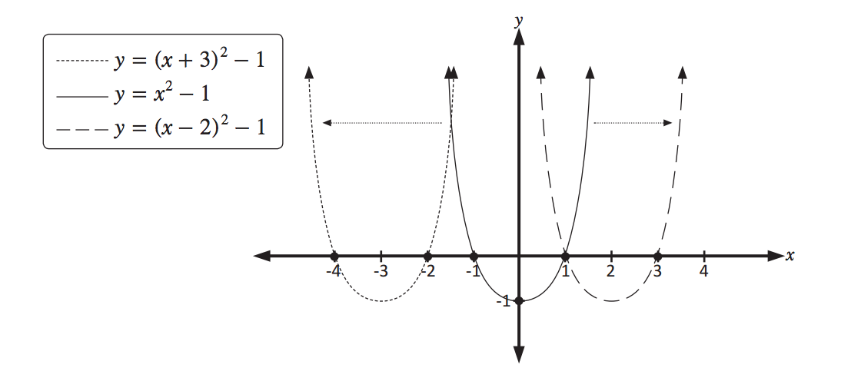
Topic : Quadratics Transformation
What are the transformations of a parabola?
What happens when we move Parabolas Horizontally?

Slide 5
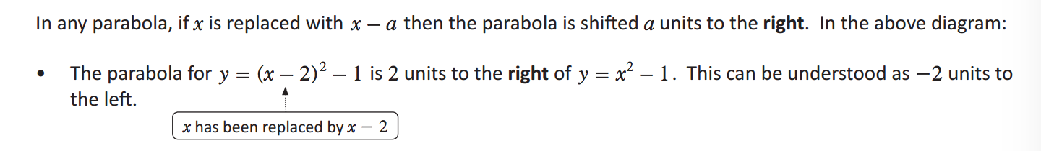
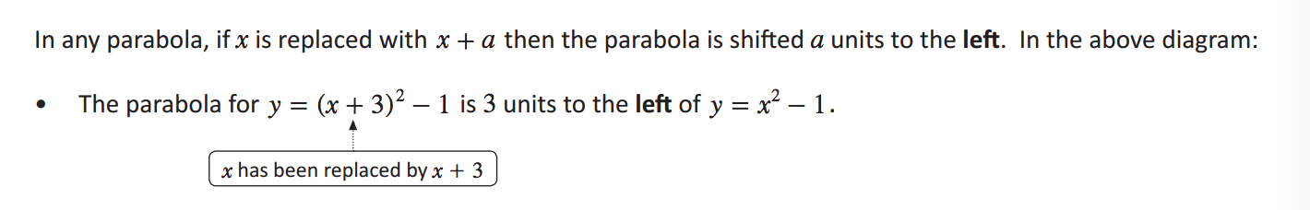
Topic : Quadratics Transformation
What are the transformations of a parabola?
What happens when we move Parabolas Horizontally?

Slide 6

Guided practice
Describe and sketch the transformations of the parabola from $y=x^{2}$
$y=3x^{2}$
$y={0.25x}^{2}$
$y=x^{2}−3$
$y={2x}^{2}$+4
$y={(x+2)}^{2}$
$y={(x−5)}^{2}+2$

Slide 7
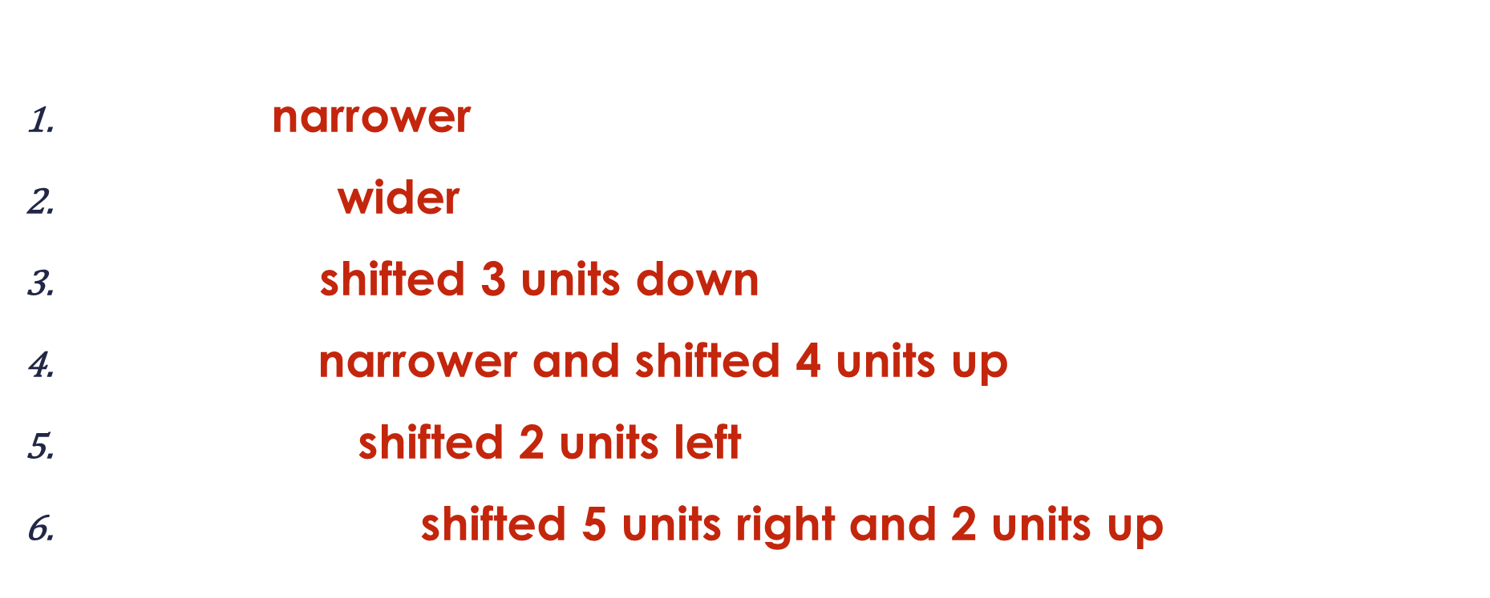
Guided practice
https://www.desmos.com/calculator
Describe and sketch the transformations of the parabola from $y=x^{2}$
$y=3x^{2}$ narrower
$y={0.25x}^{2}$ wider
$y=x^{2}−3$ shifted 3 units down
$y={2x}^{2}$+4 narrower and shifted 4 units up
$y={(x+2)}^{2}$ shifted 2 units left
$y={(x−5)}^{2}+2$ shifted 5 units right and 2 units up
Notes:
https://www.desmos.com/calculator

Slide 8
Write your summaries
Exercise 16.7 page 220
Sketch and describe the transformations

Slide 9

Topic : Quadratics Transformation
What are the transformations of a parabola?
$$y=ax^{2}+bx+c where a≠0$$
How do we find the vertex of a parabola?
$$x=−\frac{b}{2a}$$
This will give us the axis of symmetry line and then we can plug the x value into the equation to get the y and a full coordinate (x,y) point

